Slide 1
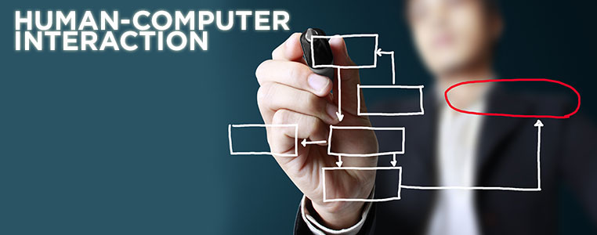
A Better Future – A Better World!
Chapter 1
Introduction
Compiled by:Musa (MSc.)

Slide 2
HCI definition
Human–computer interaction (HCI) is the study of how humans interact with computer systems and
to what extent computers are or are not developed for successful interaction with human beings.
Concerned with the design, evaluation and implementation of interactive computing systems for human use and with the study of major phenomena surrounding them.
HCI consists of three parts:
The user(human), the computer itself(desktop ,mobile devices, websites…), and the ways they work together.
In their daily lives, people use a number of computer-based technologies directly or indirectly through user interface.
User interface is part of the computer system that enables interaction and serves as a bridge between users and the system.

Slide 3
GOALS of HCI
A basic goal of HCI is:
to improve the interactions between users and computers
by making computers more usable and receptive to the user's needs.
A long term goal of HCI is:
to design systems that minimize the barrier between the human's cognitive model of what they want.
to accomplish and the computer's understanding of the user's task.
WHY IS HCI IMPORTANT
User-centered design is getting a crucial role!
It is getting more important today to increase competitiveness via HCI studies (Norman, 1990).
High-cost e-transformation investments.
Users lose time with badly designed products and services.
Users even give up using bad interface
Ineffective allocation of resources

Slide 4
Disciplines contribute to HCI
Computer Science − For application design and engineering.
Psychology − For application of theories and analytical purpose.
Sociology − For interaction between technology and organization.
Industrial Design − For interactive products like mobile phones, microwave oven, etc.
Ergonomics :for application of ways of physical interactions.

Slide 5
The Importance of Good UI Design
“Good” UI is
Easy to learn, effective to use, easy to understand.
Encourages an easy, natural, and engaging interaction between a user and a system,
Allows users to carry out their required tasks.
User interface strongly affects perception of software.
Usable software sells better.
Unusable web sites are abandoned/rejected.

Slide 6
The Problems of Poor or Bad UI
Poor UI design
may prevent some people away from a system permanently.
can led to Dissatisfaction, frustration, and increased stress.
can have a huge financial cost to users and organizations.
A critical system, such as one used in air traffic control or in a nuclear power plant, may compromise the safety of its users and/or the general public.

Slide 7
Usability
A UI is good or bad in relation to its usability.
usability measures how well users can use the system’s functionality.
It is also refers to methods for improving ease-of-use during the design process.
Dimensions of usability
Learnability: is it easy to learn?
Efficiency: once learned, is it fast to use?
Memorability: is it easy to remember what you learned?
Errors: are errors few and recoverable?
Satisfaction: is it enjoyable to use?

Slide 8
Usability Dimensions Vary In Importance
Depends on the user
Novice(beginner) users need learnability
Infrequent users need memorability
Experts need efficiency
But no user is uniformly novice or expert
Domain experience
Application experience
Feature experience

Slide 9
Software designers have a lot to worry about:
Functionality
Usability
Performance
Size
Cost
Reliability
Security
Standards
Many design decisions involve tradeoffs among different attributes
usability will be our primary goal.

Slide 10
UI Are Hard to Design and Build
Most software engineering/development is about communicating with other programmers.
UI is about communicating with users.
User interface takes a lot of software development effort.

Slide 11
History
1945 – MEMEX by Vanevar Bush
1963 – SketchPad and Light Pen by Ivan Sutherland
1964 – Mouse by Douglas Engelbart
1973 – Alto by Xerox PARK
1983 – Apple Lisa
1987 – Windows 1.0

Slide 12
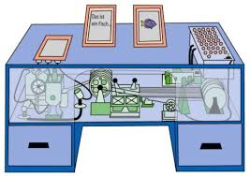
1945 – MEMEX by Vanevar Bush
The memex (a combination of "memory" and "index" or "memory" and "extender").
Is the name of the hypothetical proto-hypertext system that Bush introduced during the 1945s,
He imagined as a form of memory augmentation involving a microfilm-based "device in which an individual stores all his books, records, and communications, and which is mechanized so that it may be consulted with exceeding speed and flexibility

Slide 13
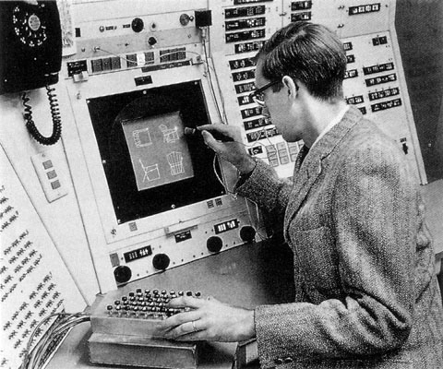
1963 – SketchPad and Light Pen by Ivan Sutherland
Ivan Sutherland is considered by many to be the creator of Computer Graphics and an Internet pioneer.
Starting with his Ph.D. thesis, named Sketchpad, which is one of the most influential computer programs ever written by an individual,
Sutherland has contributed numerous ideas to the study of Computer Graphics and Computer Interaction.
He introduced concepts such as 3-D computer modeling, visual simulations, computer aided design (CAD), virtual reality, etc.

Slide 14
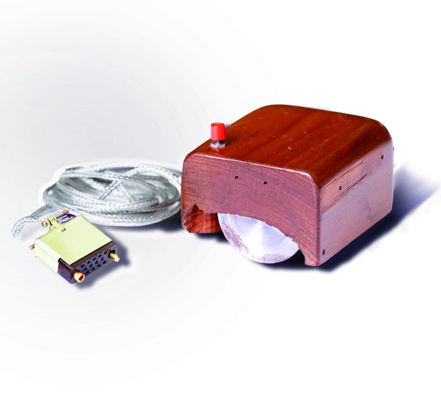
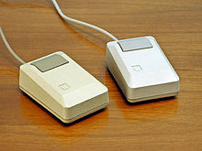
1964 – Mouse by Douglas Engelbart
Douglas Carl Engelbart is best known for his work on the challenges of human–computer interaction, particularly while at his Augmentation Research Center Lab,
resulting in the invention of the computer mouse, and the development of hypertext, networked computers, and precursors to graphical user interfaces.
Apple Macintosh Plus mice, 1986

Slide 15
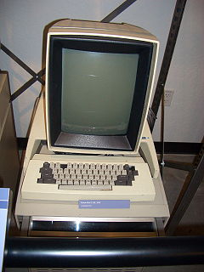
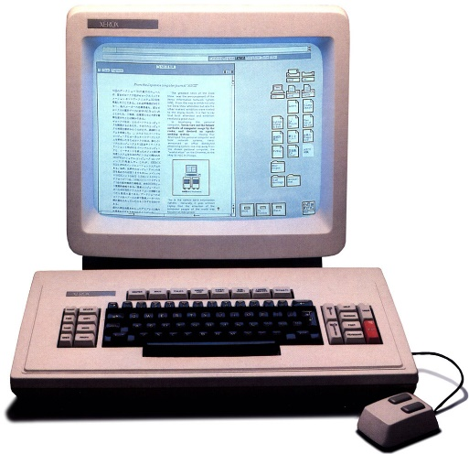
1973 – Alto by Xerox PARK
The Xerox Alto was one of the first personal computers (a term that was already coined at the time),
a general purpose computer designed for individual use (although not as a home computer).
However it was expensive and, unlike modern personal computers, not based on a microprocessor.
It was the first computer to use a desktop metaphor, first commercialized on the later Xerox Star, and one of the first with a mouse-driven graphical user interface.
Xerox Alto
Xerox Star

Slide 16
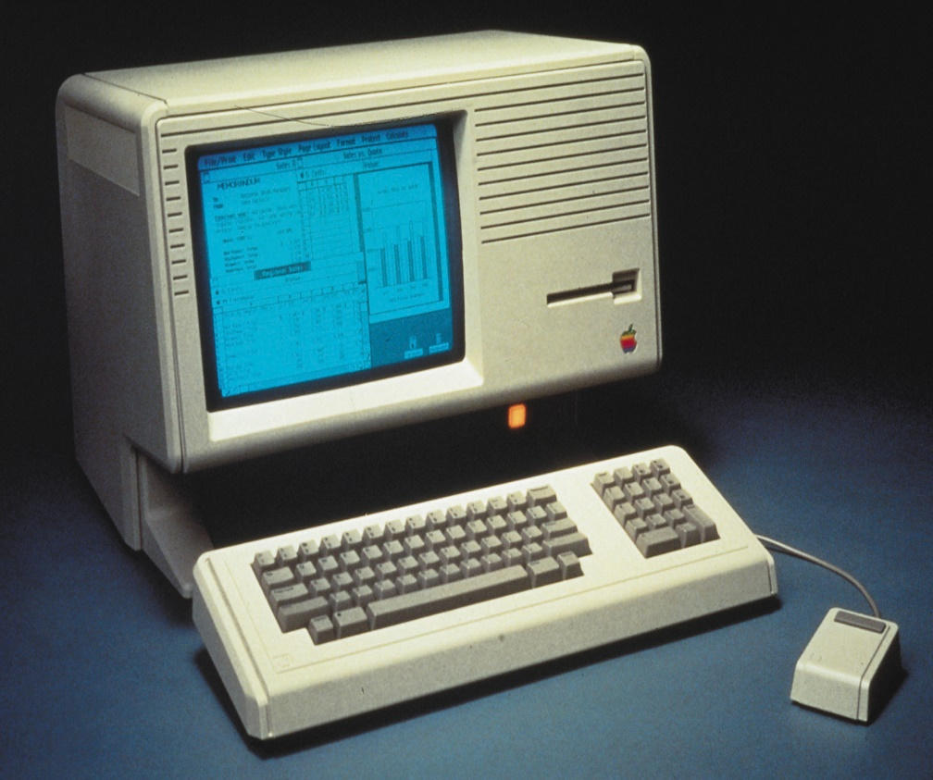
1983 – Apple Lisa
The Lisa is a personal computer designed by Apple Computer, Inc. during the early 1980s.
It was the first personal computer to offer a graphical user interface in an inexpensive machine aimed at individual business users.
Development of the Lisa began in 1978.
It was the second personal computer system with a graphical user interface (GUI) to be sold commercially, the first being the Xerox Star.
It used a Motorola 68000 CPU clocked at 5 MHz and had 1 MB RAM.

Slide 17
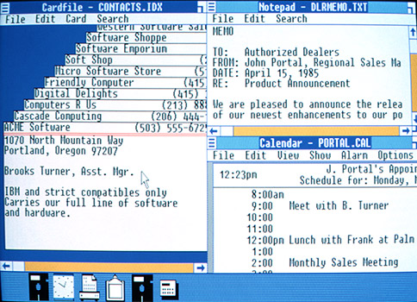
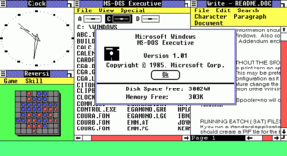
1987 – Windows 1.0
Windows 1.0 is a graphical personal computer operating environment developed by Microsoft.
First released on 20 November 1985 as the first version of the Microsoft Windows line,
Windows 1.0 runs as a graphical, 16-bit multi-tasking shell on top of an existing MS-DOS installation, providing an environment which can run graphical programs designed for Windows, as well as existing MS-DOS software.

Slide 18
Reading Assignment
Read and write in detail about the following terms
Linux
Mac OS
Interaction Design
Current status of HCI

Slide 19
Thank you!

